Slide 1
Project 12.2
Isis Lara

Slide 2
Problem Statement
By understanding customer feedback and sentiment to forecast trends and potential issues before they become ubiquitous and prioritize improvements.

Slide 3
Approach
Combine structured and unstructured data to perform a regression analysis and predict ratings

Slide 4
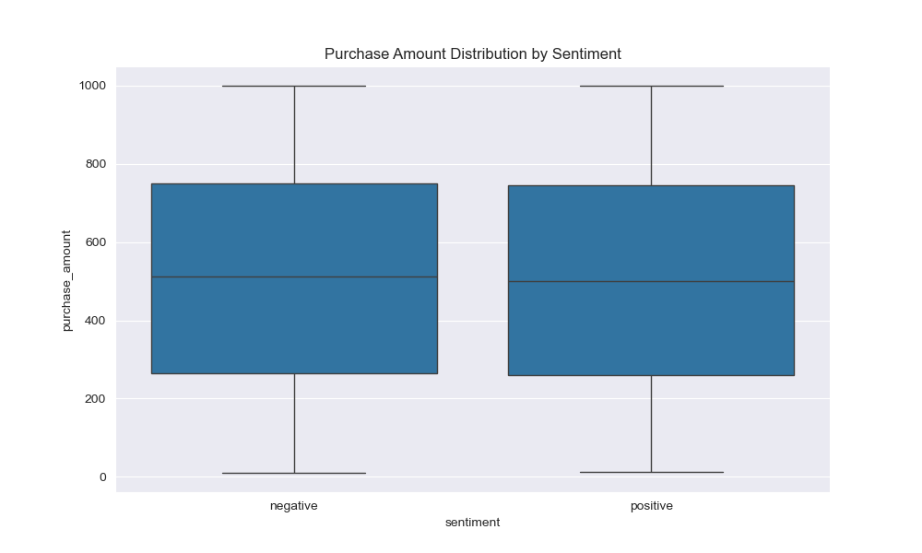
Sentiment Purchase Distribution

Slide 5
Results and Insights
The accuracy score is low, and the RMSE falls far from the measured true values
Everything must run in Google Colab
The residuals are not symmetrically distributed and cluster away from the middle of the plot
Model is not a perfect subject for advancement, and further tuning is suggested

